Slide 1

Amazon Sales Dashboard – Power BI Project
© 2025 Amazon Sales Report | Created by Prafull Wahatule

Slide 2


Project
Introduction
The Amazon Sales Dashboard is an interactive Power BI project designed to analyze and visualize e-commerce sales data. It helps businesses monitor key metrics like sales, orders, quantity, fulfilment, and promotions — all in one place. With real-time insights, this dashboard supports data-driven decision-making, improves operational efficiency, and helps identify growth opportunities across regions and product categories.
© 2025 Amazon Sales Report | Created by Prafull Wahatule

Slide 3
Project
Overview
This project presents an interactive Power BI dashboard built to analyze Amazon sales performance across multiple dimensions such as product, region, fulfilment, and promotions. It provides a centralized view of business metrics, enabling quick insights into revenue trends, top-performing categories, and operational efficiency. The dashboard helps stakeholders make data-driven decisions through real-time filtering, dynamic visuals, and forecasting analytics.
© 2025 Amazon Sales Report | Created by Prafull Wahatule

Slide 4
Project
Problem Statement
Businesses often struggle to track and analyze large amounts of sales data across multiple parameters such as products, regions, fulfilment types, and promotions. Manual reporting methods are slow and prone to errors, making it difficult to gain timely insights. Due to the lack of an interactive and centralized dashboard, decision-makers face challenges in identifying trends, monitoring KPIs, and making accurate data-driven decisions.
© 2025 Amazon Sales Report | Created by Prafull Wahatule

Slide 5
Project
Objective
Analyze Amazon sales data across products, regions, fulfilment, and promotions
Analyze Amazon sales data across products, regions, fulfilment, and promotions
Track key KPIs like Total Sales, Orders, Quantity Sold, and AOV.
Forecast future sales trends for data-driven decision making.
Evaluate fulfilment & promotions to measure operational efficiency.
Identify top-performing products & regions for better business planning.
© 2025 Amazon Sales Report | Created by Prafull Wahatule

Slide 6
Project
Outcome
Gained clear visibility into overall Amazon sales performance across multiple dimensions.
Identified top-performing products, regions, and fulfilment types for better business planning.
Improved marketing and inventory strategies using promotional and category insights.
Delivered a fully interactive Power BI dashboard for faster and smarter decision-making.
© 2025 Amazon Sales Report | Created by Prafull Wahatule

Slide 7
Content
Table
Data Source & Description
Data Cleaning & Transformation
01
02
Exploratory Data Analysis (EDA)
Dashboard Design & Visualization
03
04
Key Insights & Findings
Tools & Technologies Used
05
06
07
Conclusion
© 2025 Amazon Sales Report | Created by Prafull Wahatule

Slide 8

01
Data Source & Description
© 2025 Amazon Sales Report | Created by Prafull Wahatule

Slide 9

The dataset used for this project is a Retail Sales (Amazon Orders) dataset.
It contains detailed information about customer orders, products, fulfilment types, cities, quantities, prices, and delivery status.
The data was provided in CSV/Excel format and imported directly into Power BI Desktop.
Each record represents a single order item with attributes like Order ID, Date, Category, Size, Qty, Total Amount, City, and Status.
© 2025 Amazon Sales Report | Created by Prafull Wahatule

Slide 10

02
Data Cleaning & Transformation
© 2025 Amazon Sales Report | Created by Prafull Wahatule

Slide 11

The raw Amazon sales dataset underwent multiple cleaning and transformation steps in Power Query Editor to ensure data accuracy, consistency, and readiness for analysis. Each step was carefully applied to remove unnecessary data, fix quality issues, and enhance analytical usability.
Key Cleaning Steps:
01
Loaded Raw Data:
Imported the CSV file containing 1,28,975 rows and 24 columns.
02
Removed Unnecessary Columns: Dropped irrelevant fields such as index, Style, ASIN, ship-postal-code, Unnamed: 22, Sales Channel, Currency, and Country to keep only relevant business attributes.
© 2025 Amazon Sales Report | Created by Prafull Wahatule

Slide 12

03
Error & Blank Handling:
Removed error values, blank rows, and duplicates to ensure data quality.
Duplicates removed: 6 rows
Total rows after cleanup: 1,16,165
06
Date-Based Columns Added: Extracted Year, Month, and Week from order date for time-series analysis.
Final dataset is fully structured, clean, and optimized for Power BI reporting — supporting accurate KPI calculations, visualizations, and forecasting analysis.
04
Quantity & Amount Handling:
Managed rows with missing or zero Qty values and recalculated totals.
Added a new calculated column Total Amount (Qty * Item Price).
Removed null and zero-value errors, resulting in 1,13,698 clean records.
05
Categorization Columns Created:
Added Order Type (Amazon vs Merchant) for fulfilment classification.
Created Order Status Group to group order outcomes (Shipped, Cancelled, Returned).
Added Promotion Type to differentiate promotional vs non-promotional sales.
© 2025 Amazon Sales Report | Created by Prafull Wahatule

Slide 13

03
Exploratory Data Analysis (EDA)
© 2025 Amazon Sales Report | Created by Prafull Wahatule

Slide 14

After cleaning the dataset, Exploratory Data Analysis was performed to understand sales patterns, customer behavior, and key business insights. This step helped in identifying the most important trends and performance indicators before visualization.
Key analysis performed:
Sales Distribution Analysis: Checked total sales, average order value, and quantity sold to understand overall business performance.
Category-Level Analysis: Examined which product categories drive maximum revenue and orders.
© 2025 Amazon Sales Report | Created by Prafull Wahatule

Slide 15

Fulfilment Comparison: Compared Amazon (FBA) vs Merchant (FBM) fulfilment to find which performs better.
Regional Insights: Explored state-wise and city-wise sales to identify top and low-performing regions.
Time Trend Analysis: Studied month-wise and seasonal patterns to detect high-demand periods.
Customer Segment Study: Analyzed B2B vs B2C contribution to total revenue.
These findings laid the foundation for creating meaningful and insight-driven Power BI dashboards.
© 2025 Amazon Sales Report | Created by Prafull Wahatule

Slide 16

04
Dashboard Design & Visualization
© 2025 Amazon Sales Report | Created by Prafull Wahatule

Slide 17
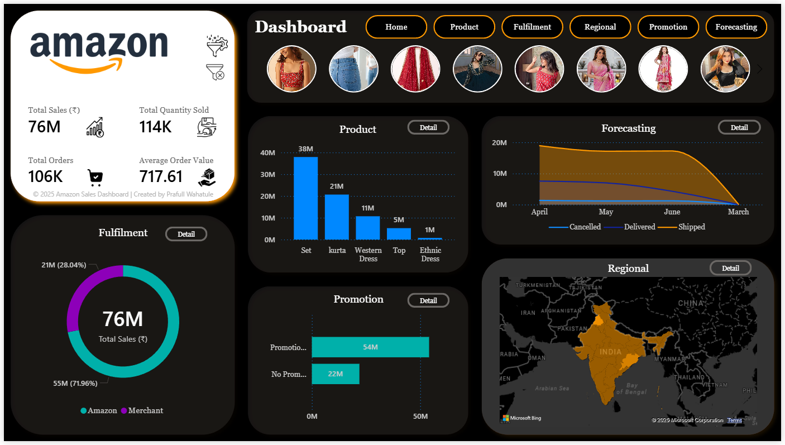
Overview: The Overview Page provides a complete summary of overall Amazon sales performance. It helps stakeholders quickly identify key business trends, monitor sales performance, and find growth opportunities at a glance.
Fulfilment by Total Sales
Compares Amazon (FBA) vs Merchant (FBM) contribution.
Top 5 Category by Total Sales
Displays best-performing categories based on revenue.
State Wise Total Sales
Geographical map showing regional sales performance.
Promotion Type by Total Sales
Shows how promotions impact total revenue.
Monthly Sales Trend
Tracks month-wise sales growth and seasonality.
© 2025 Amazon Sales Report | Created by Prafull Wahatule

Slide 18
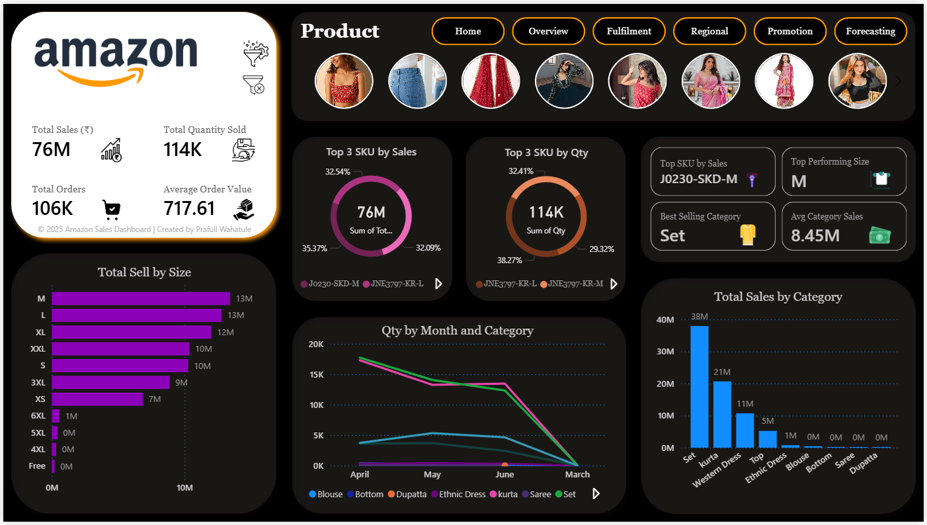
Product: The Product Page provides a detailed view of product-level performance and demand trends. It helps stakeholders identify top-selling categories, SKUs, and sizes — enabling smarter decisions in inventory planning, marketing, and sales strategy.
Top 3 SKU by Total Quantity
Highlights most sold SKUs by volume.
Quantity by Month & Category
Tracks monthly demand fluctuations across categories.
Top 3 SKU by Total Sales
Displays SKUs generating the highest revenue.
Total Sales by Category Compares category-wise revenue performance to find top contributors.
Total Sales by Size Shows which size variants contribute most to total sales.
© 2025 Amazon Sales Report | Created by Prafull Wahatule

Slide 19
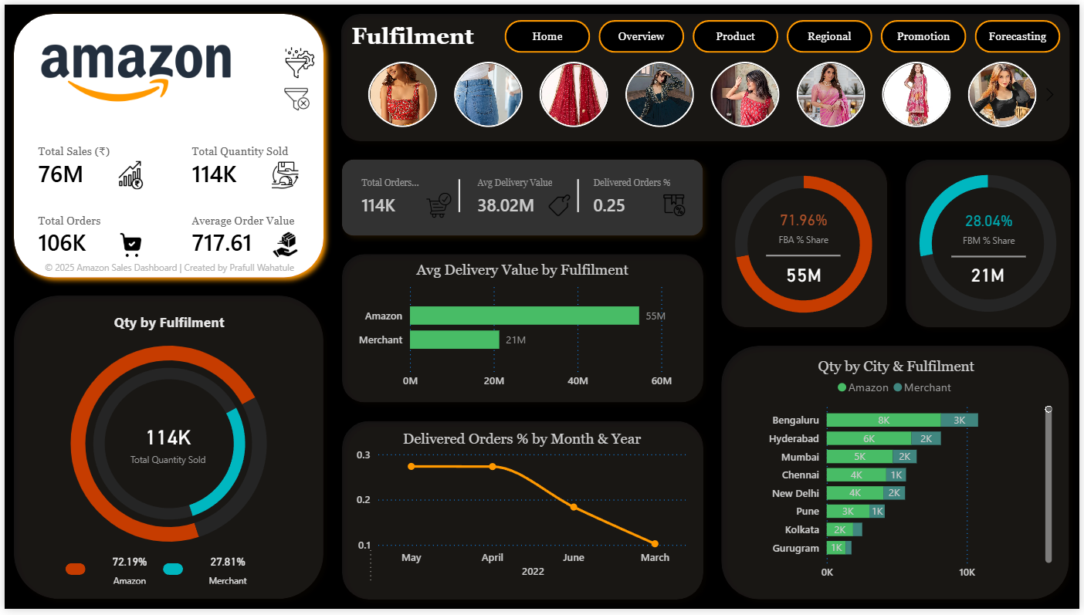
Fulfilment: The Fulfilment Page provides insights into delivery performance and operational efficiency. It helps stakeholders compare Amazon (FBA) and Merchant (FBM) fulfilment models to identify performance gaps, monitor delivery success, and improve logistics strategy.
FBA & FBM Share %
Displays Amazon’s & Merchant contribution to total sales.
Quantity by City & Fulfilment Highlights city-wise fulfilment volume for operational planning.
Delivered Orders % by Month
Tracks monthly delivery success rates and efficiency trends.
Quantity by Fulfilment Compares total quantity handled by FBA and FBM.
Average Delivery by Fulfilment
Shows which fulfilment model achieves higher average order value.
© 2025 Amazon Sales Report | Created by Prafull Wahatule

Slide 20
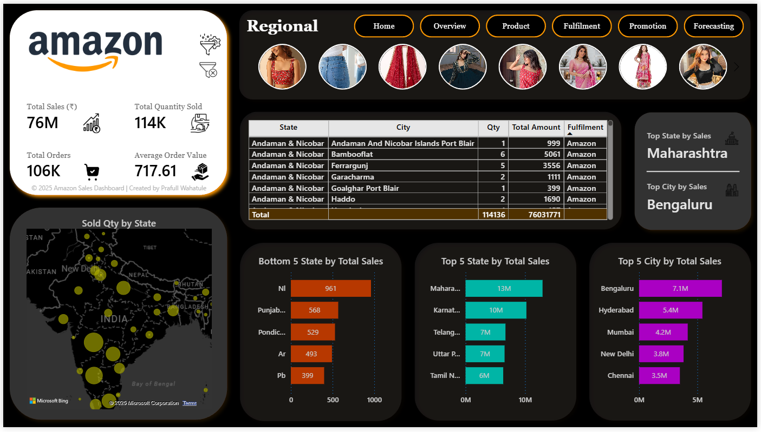
Regional: The Delivery page focuses on analyzing shipment performance and fulfilment efficiency. It helps stakeholders:
Compare Amazon (FBA) and Merchant (FBM) delivery effectiveness
Identify operational bottlenecks and improve customer experience
Delivery Efficiency Table
Displays order-wise delivery details for performance monitoring.
Monthly Delivery Trend
Tracks delivery performance and timeliness over time.
Delivery Status Overview
Shows the proportion of delivered, returned, and pending orders.
Top 5 States by Delivery Count
Highlights states with the highest delivery volumes.
Avg Delivery Time by Fulfilment
Compares average delivery duration between FBA and FBM.
© 2025 Amazon Sales Report | Created by Prafull Wahatule

Slide 21
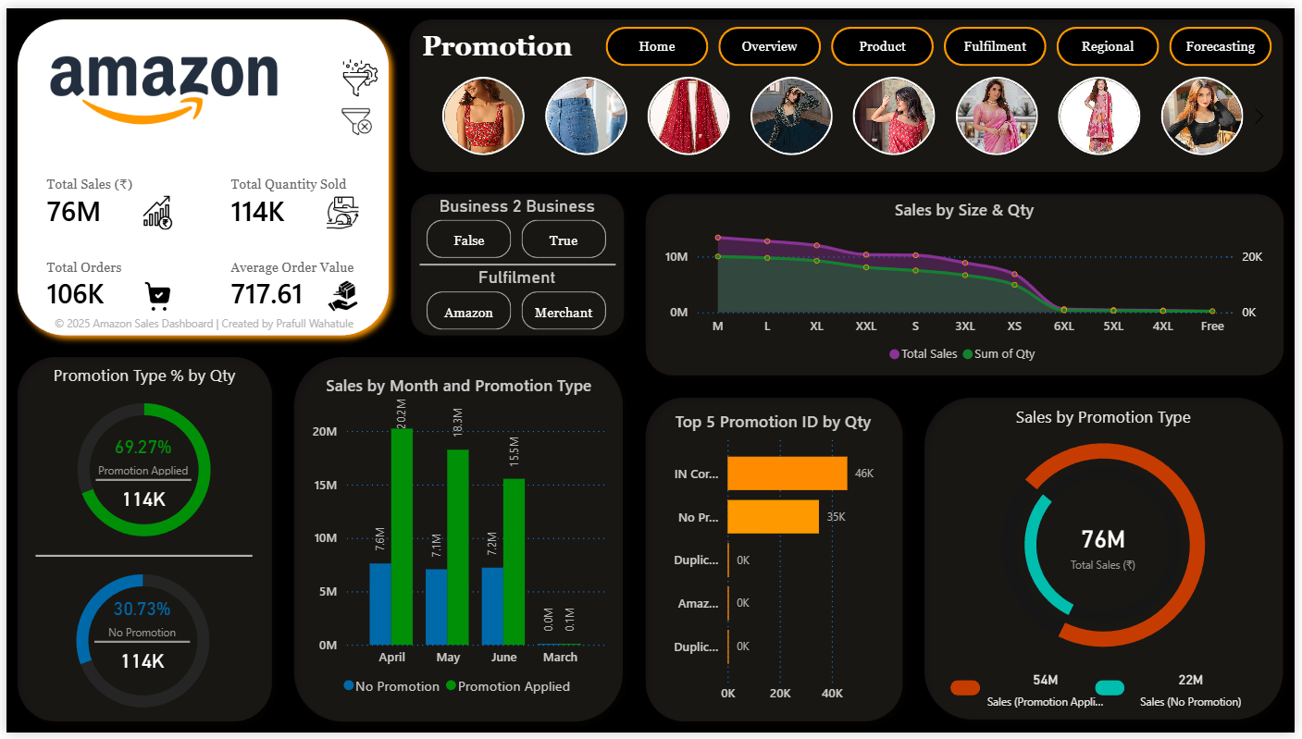
Promotion: The Promotion page focuses on evaluating sales performance influenced by promotional offers. It helps stakeholders:
Identify top-performing promotions and their contribution to revenue
Compare organic vs promotional sales to assess marketing effectiveness
Promotion Type % by Qty
Shows the share of orders made with and without promotions.
Sales by Month & Promotion Type
Tracks monthly trends for promotional vs non-promotional sales.
Sales by Size & Qty
Displays how sales vary across product sizes during promotional periods.
Top 5 Promotion IDs by Qty
Highlights the best-performing promotions by order volume.
Total Sales by Promotion Type
Compares total revenue generated under each promotion type.
© 2025 Amazon Sales Report | Created by Prafull Wahatule

Slide 22
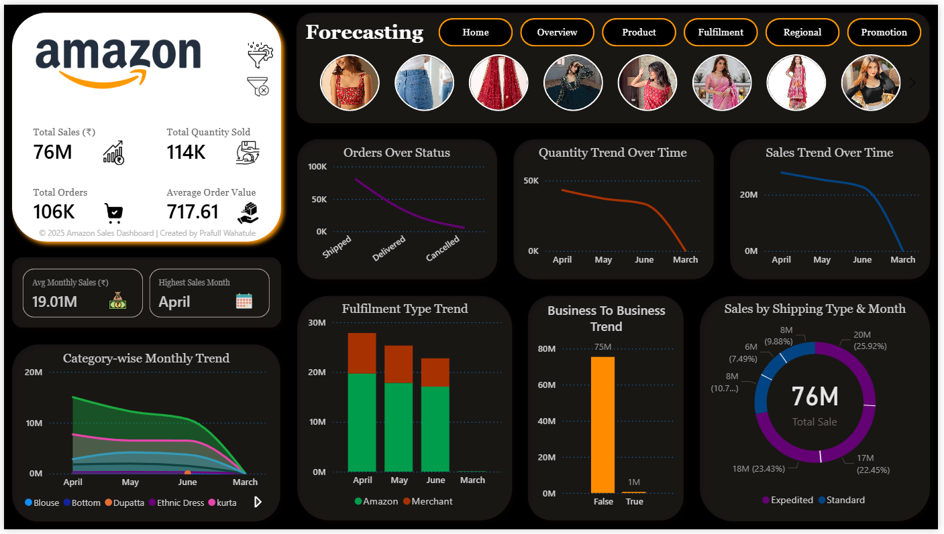
Forecasting: The Forecasting page focuses on analyzing historical sales trends and predicting future performance. It helps stakeholders:
Understand past sales patterns and seasonality
Identify peak and low-demand months
Plan inventory, marketing, and operational strategies
Sales by Shipping Type & Month
Displays monthly sales distribution by shipping type to optimize delivery.
Category Wise Monthly Trend
Highlights monthly sales of each product category to spot seasonal demand.
Business To Business Trend
Shows revenue contribution from B2B vs B2C orders for segment planning.
Fulfilment Type Trend
Compares FBA vs FBM sales per month to assess operational efficiency.
© 2025 Amazon Sales Report | Created by Prafull Wahatule

Slide 23

05
Key Insights & Findings
© 2025 Amazon Sales Report | Created by Prafull Wahatule

Slide 24

Overall Performance: Quick access to total sales, orders, quantity sold, and average order value for a complete business snapshot. (Home Page)
Top Product Categories & SKUs: Identify best-selling categories and SKUs to focus on revenue-driving products. (Overview & Product Pages)
Fulfilment Efficiency: Understand FBA vs FBM contribution, delivered order percentages, and city-wise fulfilment distribution. (Fulfilment Page)
Regional Insights: Detect high-performing and underperforming states/cities for targeted marketing, inventory, and logistics planning. (Region Page)
© 2025 Amazon Sales Report | Created by Prafull Wahatule

Slide 25

Category & Size Trends: Analyze size-specific and category-specific demand patterns to optimize production and inventory. (Product & Promotion Pages)
Forecasting & Planning: Leverage historical trends and predicted sales to plan marketing, stock, logistics, and operational strategies. (Forecasting Page)
Promotion Impact: Evaluate organic vs promotional sales and determine top-performing promotions. (Promotion Page)
Sales Trends & Seasonality: Track monthly sales growth, peaks, and dips to anticipate demand. (Overview & Forecasting Pages)
© 2025 Amazon Sales Report | Created by Prafull Wahatule

Slide 26

06
Tools & Technologies Used
© 2025 Amazon Sales Report | Created by Prafull Wahatule

Slide 27
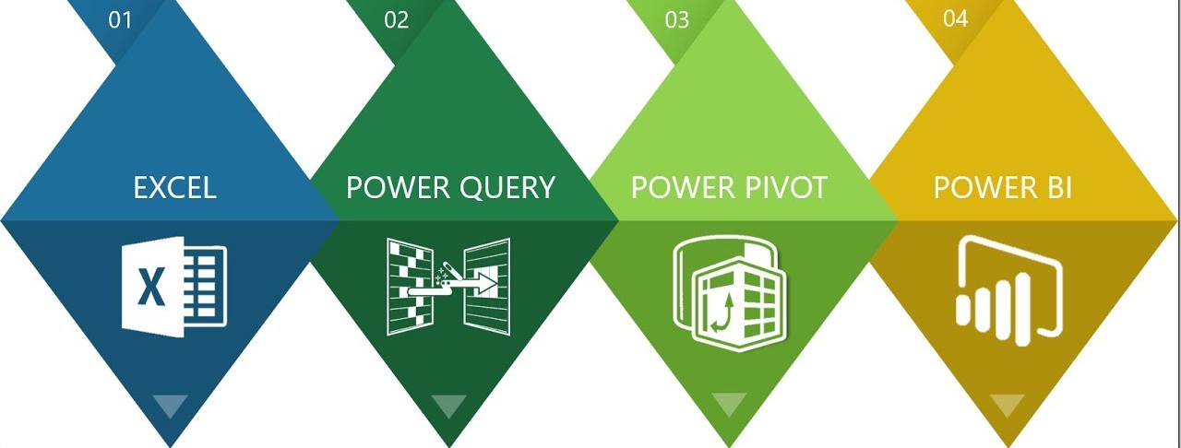
Excel / CSV Dataset – Source of Amazon sales data for analysis and reporting.
Power Query Editor – For data cleaning, transformation, and shaping before analysis.
Data Analysis Expressions – To calculate KPIs, percentages, and trends for insightful visualizations.
Microsoft Power BI Desktop – To design and build interactive reports and dashboards.
© 2025 Amazon Sales Report | Created by Prafull Wahatule

Slide 28
07
Conclusion
© 2025 Amazon Sales Report | Created by Prafull Wahatule

Slide 29

The Amazon Sales Dashboard is a simple and interactive tool to understand sales performance easily. It helps stakeholders:
View key business metrics and monthly sales trends at a glance.
Find top-selling categories, SKUs, and sizes to plan inventory and marketing better.
Compare Amazon (FBA) and Merchant (FBM) fulfilment performance.
Track state and city-wise sales to identify strong and weak regions.
Measure the impact of promotions on total sales.
Forecast future sales using past trends for better planning.
Overall, this dashboard supports data-driven decisions, improves efficiency, and helps grow business performance.
© 2025 Amazon Sales Report | Created by Prafull Wahatule

Slide 30

PRAFULL WAHTULE
GitHub
Linkedin
© 2025 Amazon Sales Report | Created by Prafull Wahatule

